Slide 1
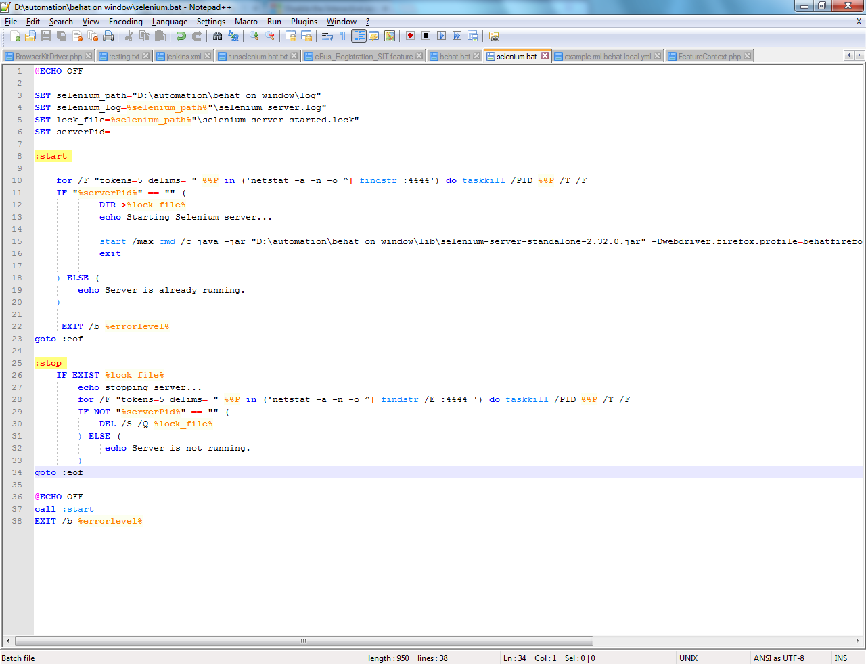
Notes:
Download Jenkins
Jenkins is an open source Continuous integration tool written in java.
Download Jenkins from http://jenkins-ci.org/ for windows and install it as windows service with default directory.
Create a folder structure in D: drive D:/automation/behat on window and install BEHAT over here by following instructions www.behat.org
Configure Jenkins
Open Jenkins.xml file in C:\Program Files (x86)\Jenkins
Change the JENKINS_HOME and arguments as below
<env name="JENKINS_HOME" value="D:\automation\behat on window"/>
<arguments>-Xrs -Xmx256m -Dhudson.lifecycle=hudson.lifecycle.WindowsServiceLifecycle -jar "C:\Program Files (x86)\Jenkins\jenkins.war" --httpPort=8080</arguments>
Write information about this batch file like
1. This selenium server we have started as a background process.
2. Explain the significance about For /F command to kill earlier server instances running if any.
3. This batch need to called from job 1 inside jenkins job.

Slide 2
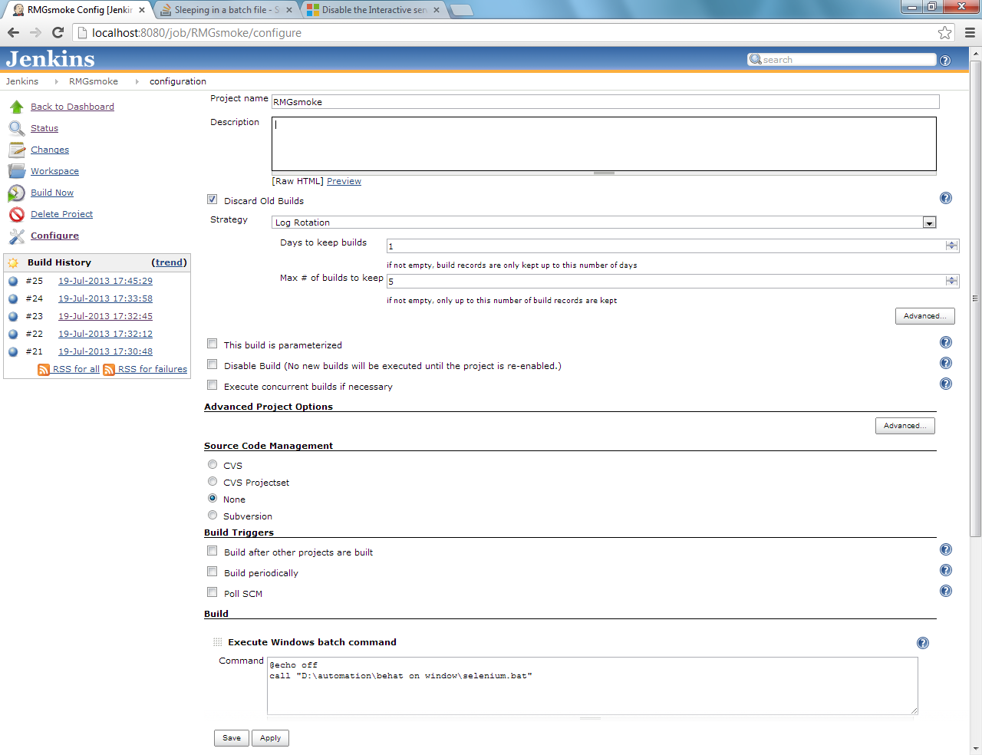
Notes:
Starting selenium server using batch file
Create a selenium.bat batch file inside D:\automation \behat on window
Write about settings inside this job1
like
discard build settings
source code management
and Execute Windows batch command

Slide 3
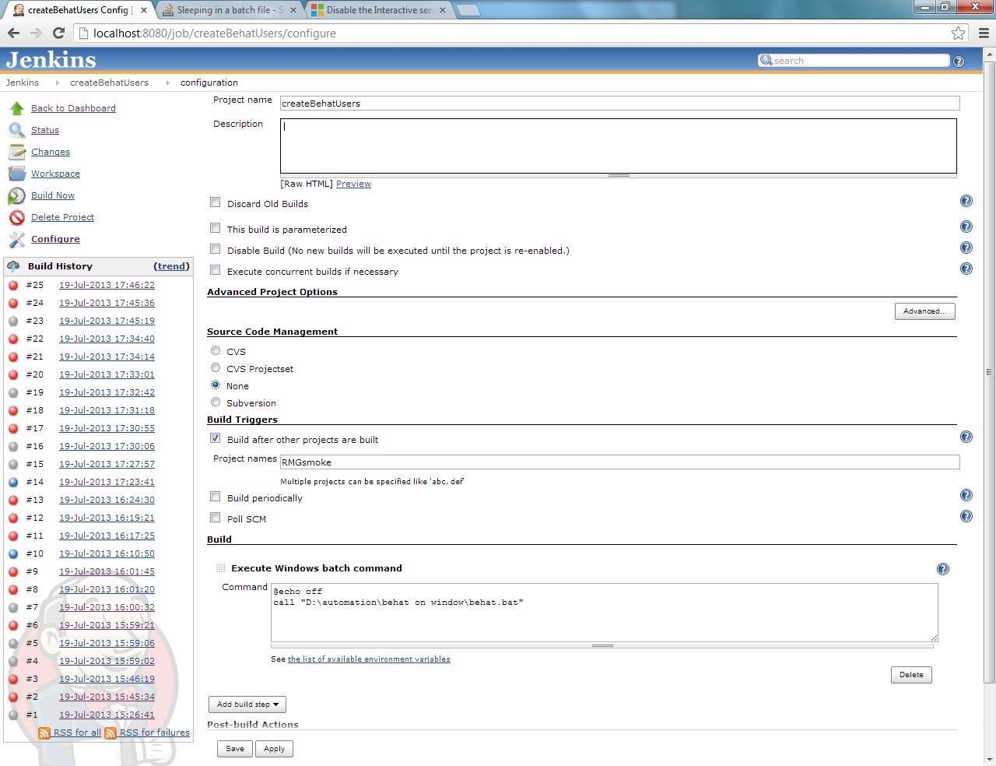
Notes:
Starting Behat Batch File
Create a BEHAT batch file inside D:\automation \behat on window
This file should contain same command that we use to run behat script.
Write information about settings in job2 file.
Execute behat command from Execute batch command.

Slide 4
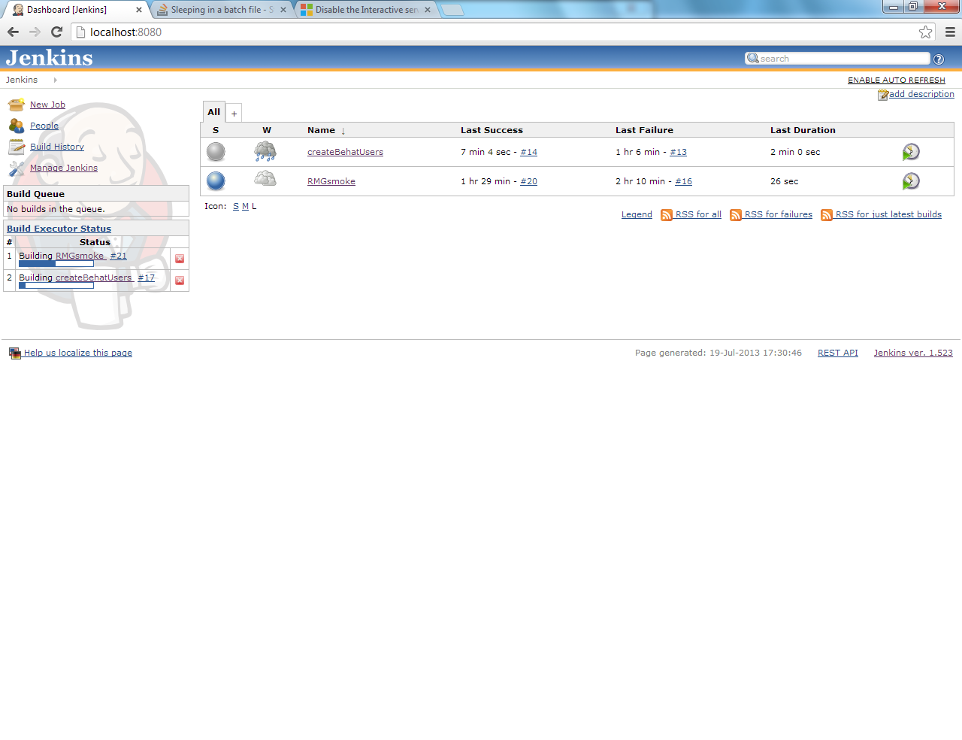
Notes:
Write information about how two jobs can be made downstream and upstream dependent
And from where these settings can be done.

Slide 5
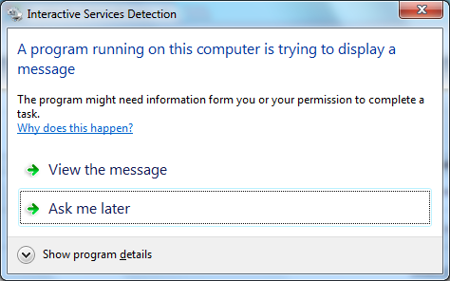
Notes:
System configuration for making Jenkins to interact with Windows
We need to make some changes in the Jenkins settings so that windows will allow Jenkins to interact to it
Setup proxy (optional)

Slide 6
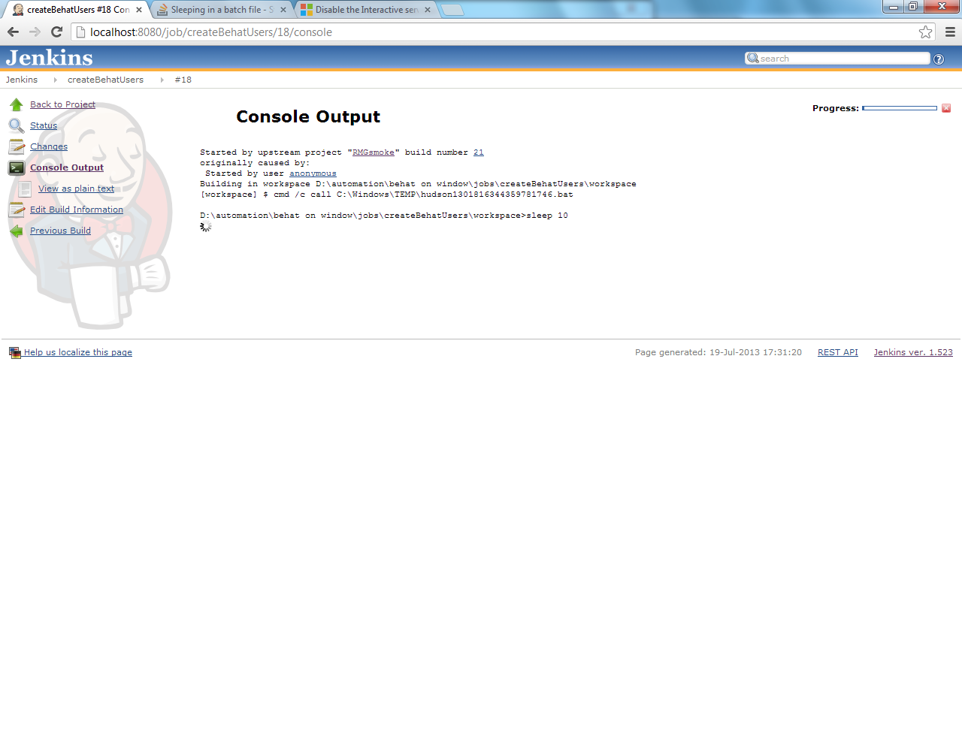
Notes:
Console output significance.

Slide 7
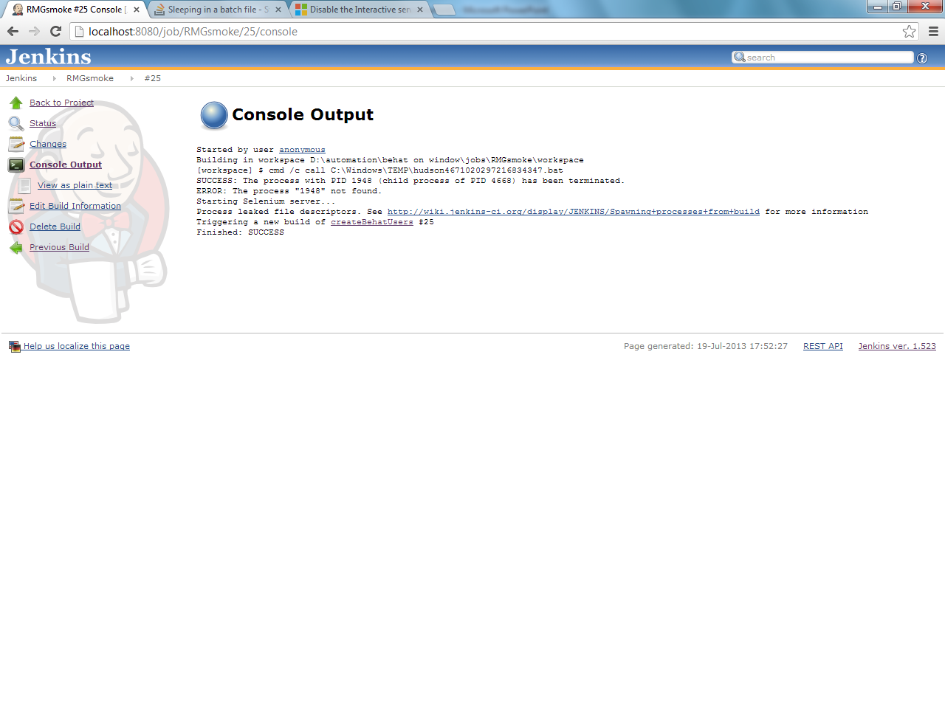
Notes:
Same as above.

Slide 8
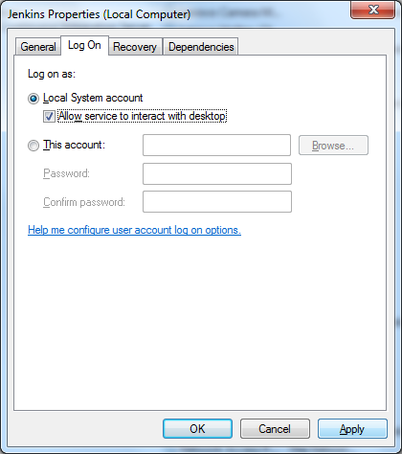
Notes:
Why this option need to be checked.
Need to explain some more about windows service and how interacts to windows.

Slide 9
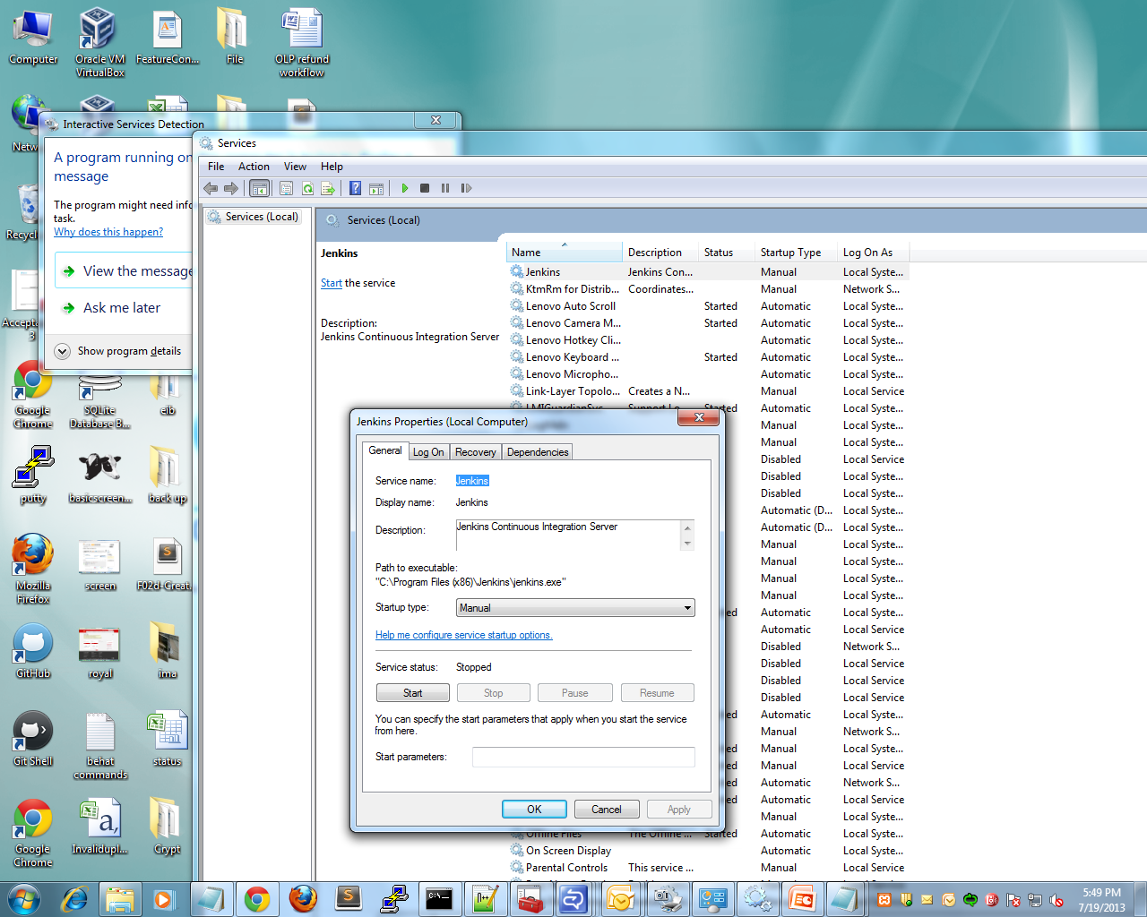

Slide 10
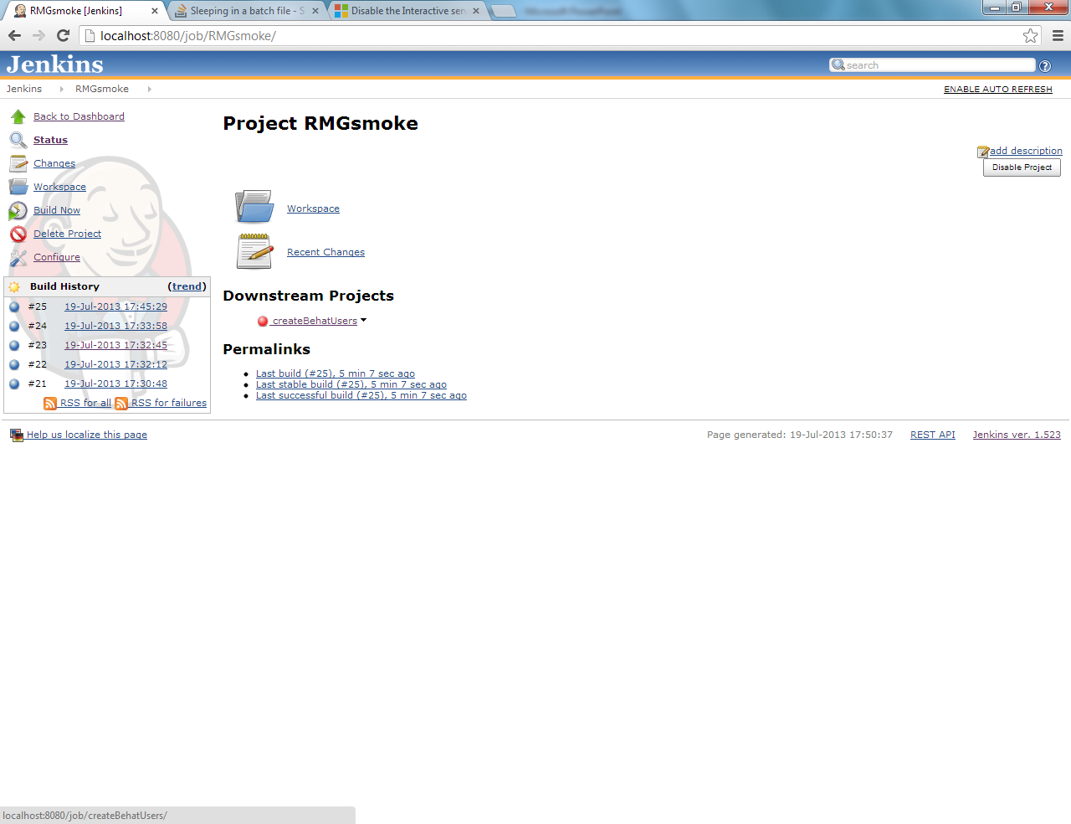
Notes:
Finally output.

